Slide 1
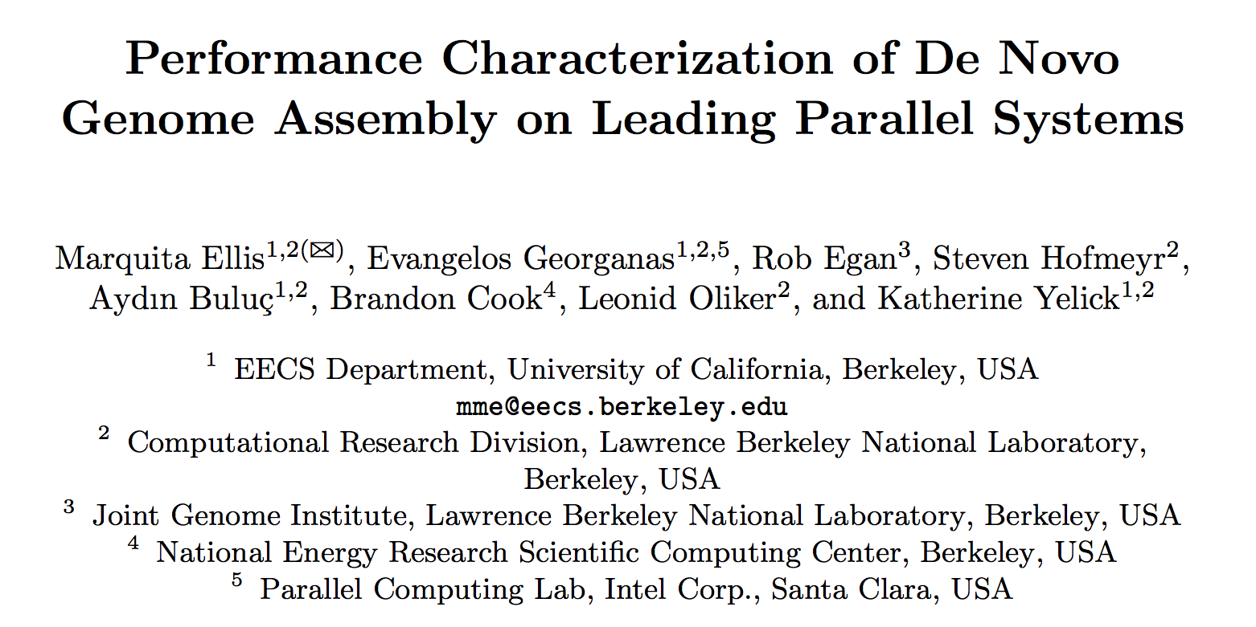
Presented by Marquita Ellis, EuroPar 2017
Notes:
Meta: 30 min. presentation slot including questions (i.e. 20-25min talk), in the “Performance and Power Modeling, Prediction and Evaluation” Session, http://europar2017.usc.es
I work on characterizing the relationships between the parallel algorithms, the hardware, and the software for a number of applications.
Today, I’m presenting our work on characterizing the performance of De Novo Genome Assembly on several leading parallel systems.

Slide 2




Introduction: Context
Genome assembly is important.
Environment
HEALTH
Notes:
Genome assembly, in and of itself, is an important problem.
Understanding the structure and characteristics of various genomes has applications in health and medicine, identifying cancer markers, creating drugs tailored to individual persons, and so on.
It also has applications to finding new energy and food sources, and many other applications in the sciences.

Slide 3
Introduction: Context
Irregular & Graph Analytic Computations
Genome Assembly
Notes:
But we’re also interested in studying genome assembly as representative of a larger class of computation, irregular and graph analytic applications in distributed systems.

Slide 4

Introduction: Context
Communication Patterns
Distributed Irregular Applications
Networks
Architectures
Notes:
In particular, we are taking a closer look at the communication patterns, the network characteristics, and the architectural characteristics underlying good parallel efficiency and scaling of these irregular applications.

Slide 5
De Novo Genome Assembly
(A Bird’s Eye View)

Slide 6
De Novo Genome Assembly, High-Level
Input
}
GCTA C GGAATAAAACCAGGAACAACAGACCCAGCAC
...
ATTAACAACAAAGGGTAAAAGGCATCATGGCTTCAG
reads
(input, typically 100-250 chars)
GCAGAAAATGGGAGTGAAAATCTCCGATGAGCAGCT
TGATGCGACGACGCACCTCGTTGTTACGCACTTCAG
Output
the fully assembled genome (or as close as we can get to it without a reference)

Slide 7
De Novo Genome Assembly, High-Level
}
GCTA C GGAATAAAACCAGGAACAACAGACCCAGCAC
...
ATTAACAACAAAGGGTAAAAGGCATCATGGCTTCAG
reads
(input, typically 100-250 chars)
GCAGAAAATGGGAGTGAAAATCTCCGATGAGCAGCT
TGATGCGACGACGCACCTCGTTGTTACGCACTTCAG
}
GCTA
ACGG
AACC
GAAT
TAAA
k-mers
(e.g. k=4)
...
CTAC
ACCA
CGGA
AATA
AAAA
TACG
AAAC
CCAG
GGAA
ATAA
(k-mer analysis and filtering based on known error and redundancy rates)

Slide 8
De Novo Genome Assembly, High-Level
k-mers are used to find overlaps
...
GCTA
AATA
CTAC
ATAA
k-mers
(e.g. k=4)
TACG
TAAA
AAAA
ACGG
AAAC
CGGA
AACC
GGAA
...
...
ACCA
GAAT
CCAG
contigs *
(typically longer than input reads)
* abbreviation for “contiguous”
}
GCTA C GGAAT
AATAAAACCAG
Notes:
We use the k-mers to find overlaps.

Slide 9
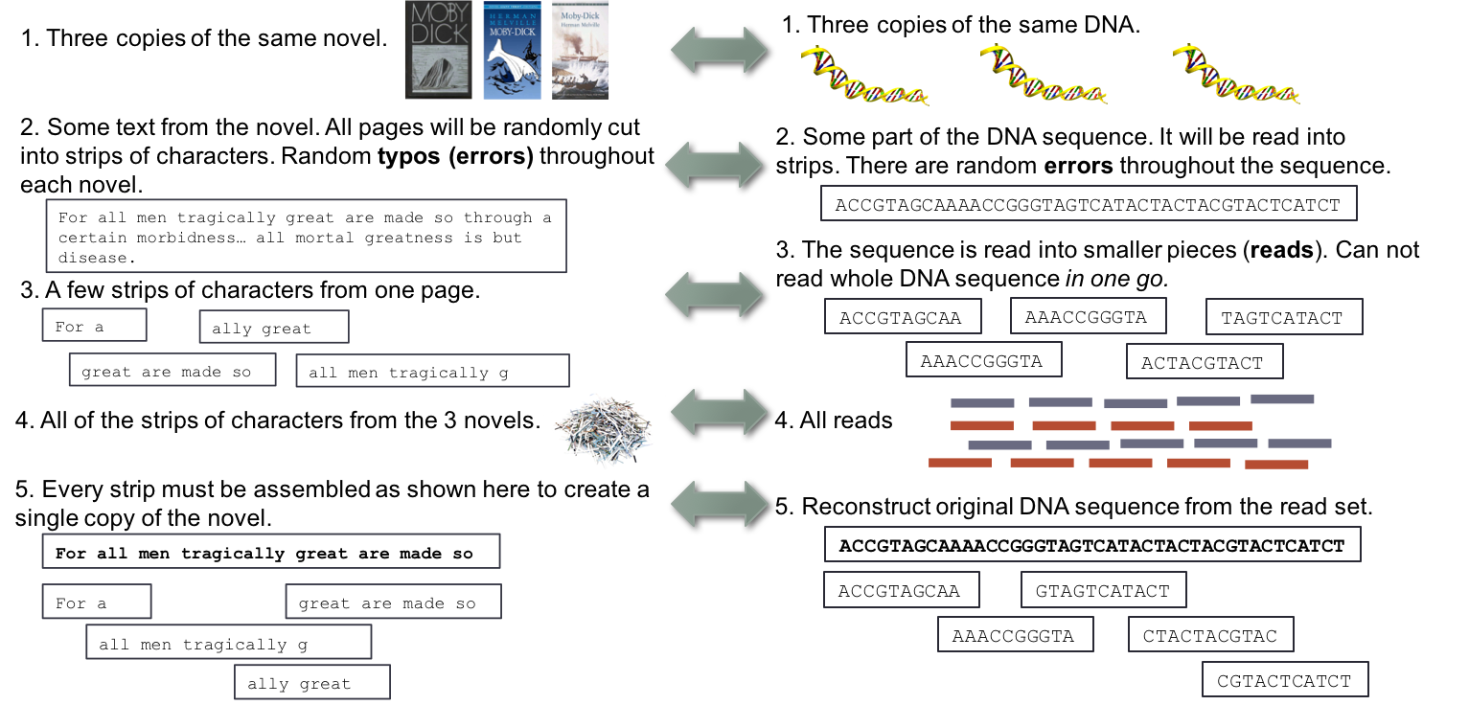
De Novo Genome Assembly, High-Level
Recap by Book Analogy

Slide 10
De Novo Genome Assembly, High-Level
Why not continue using specialized shared memory machines?
Large and variable input data set sizes
Runtime...
Notes:
This is very naturally represented or computed as a shared memory graph computation,
so why bother distributing it?
Well, the major reasons are the large and variable input data set sizes
and the respective single shared memory machine runtimes.

Slide 11
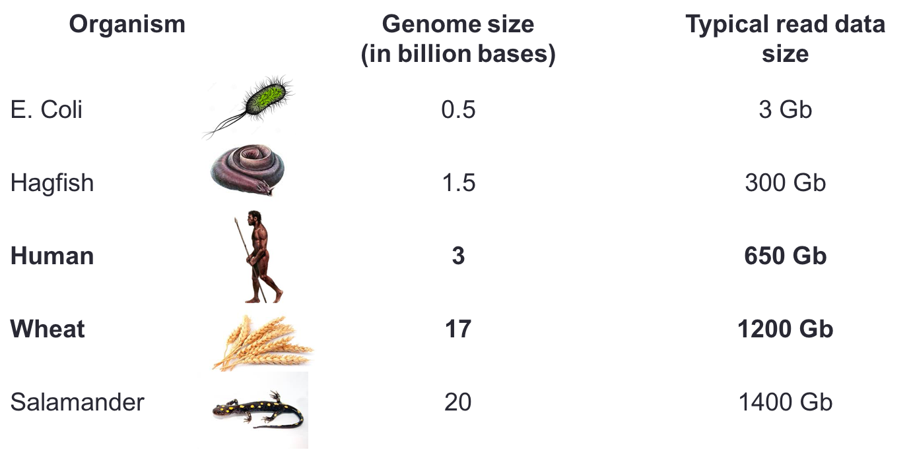
De Novo Genome Assembly, High-Level
Variable Input Sizes
Typical (compressed) read data set size
Notes:
The input data size varies by organism.

Slide 12
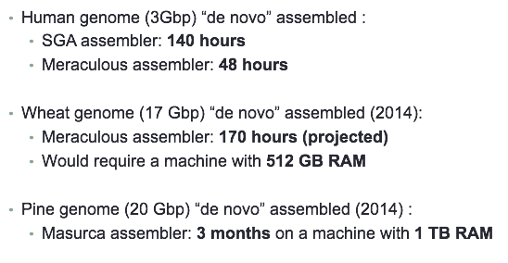
De Novo Genome Assembly, High-Level
Reference Runtimes, Shared Memory Assemblers
Notes:
String Graph assembler

Slide 13
High Performance Meraculous
(HipMer) Pipeline
Notes:
That completes the basic context for de novo genome assembly,
for more details see the paper and
Our application benchmark, HipMer, which stands for High-Performance Meraculous,
is an extreme-scale state-of-the-art distributed assembler,
which produces biologically equivalent results as Meraculous,
and is capable of assembling larger genomes than have been assembled on large shared memory machines.

Slide 14
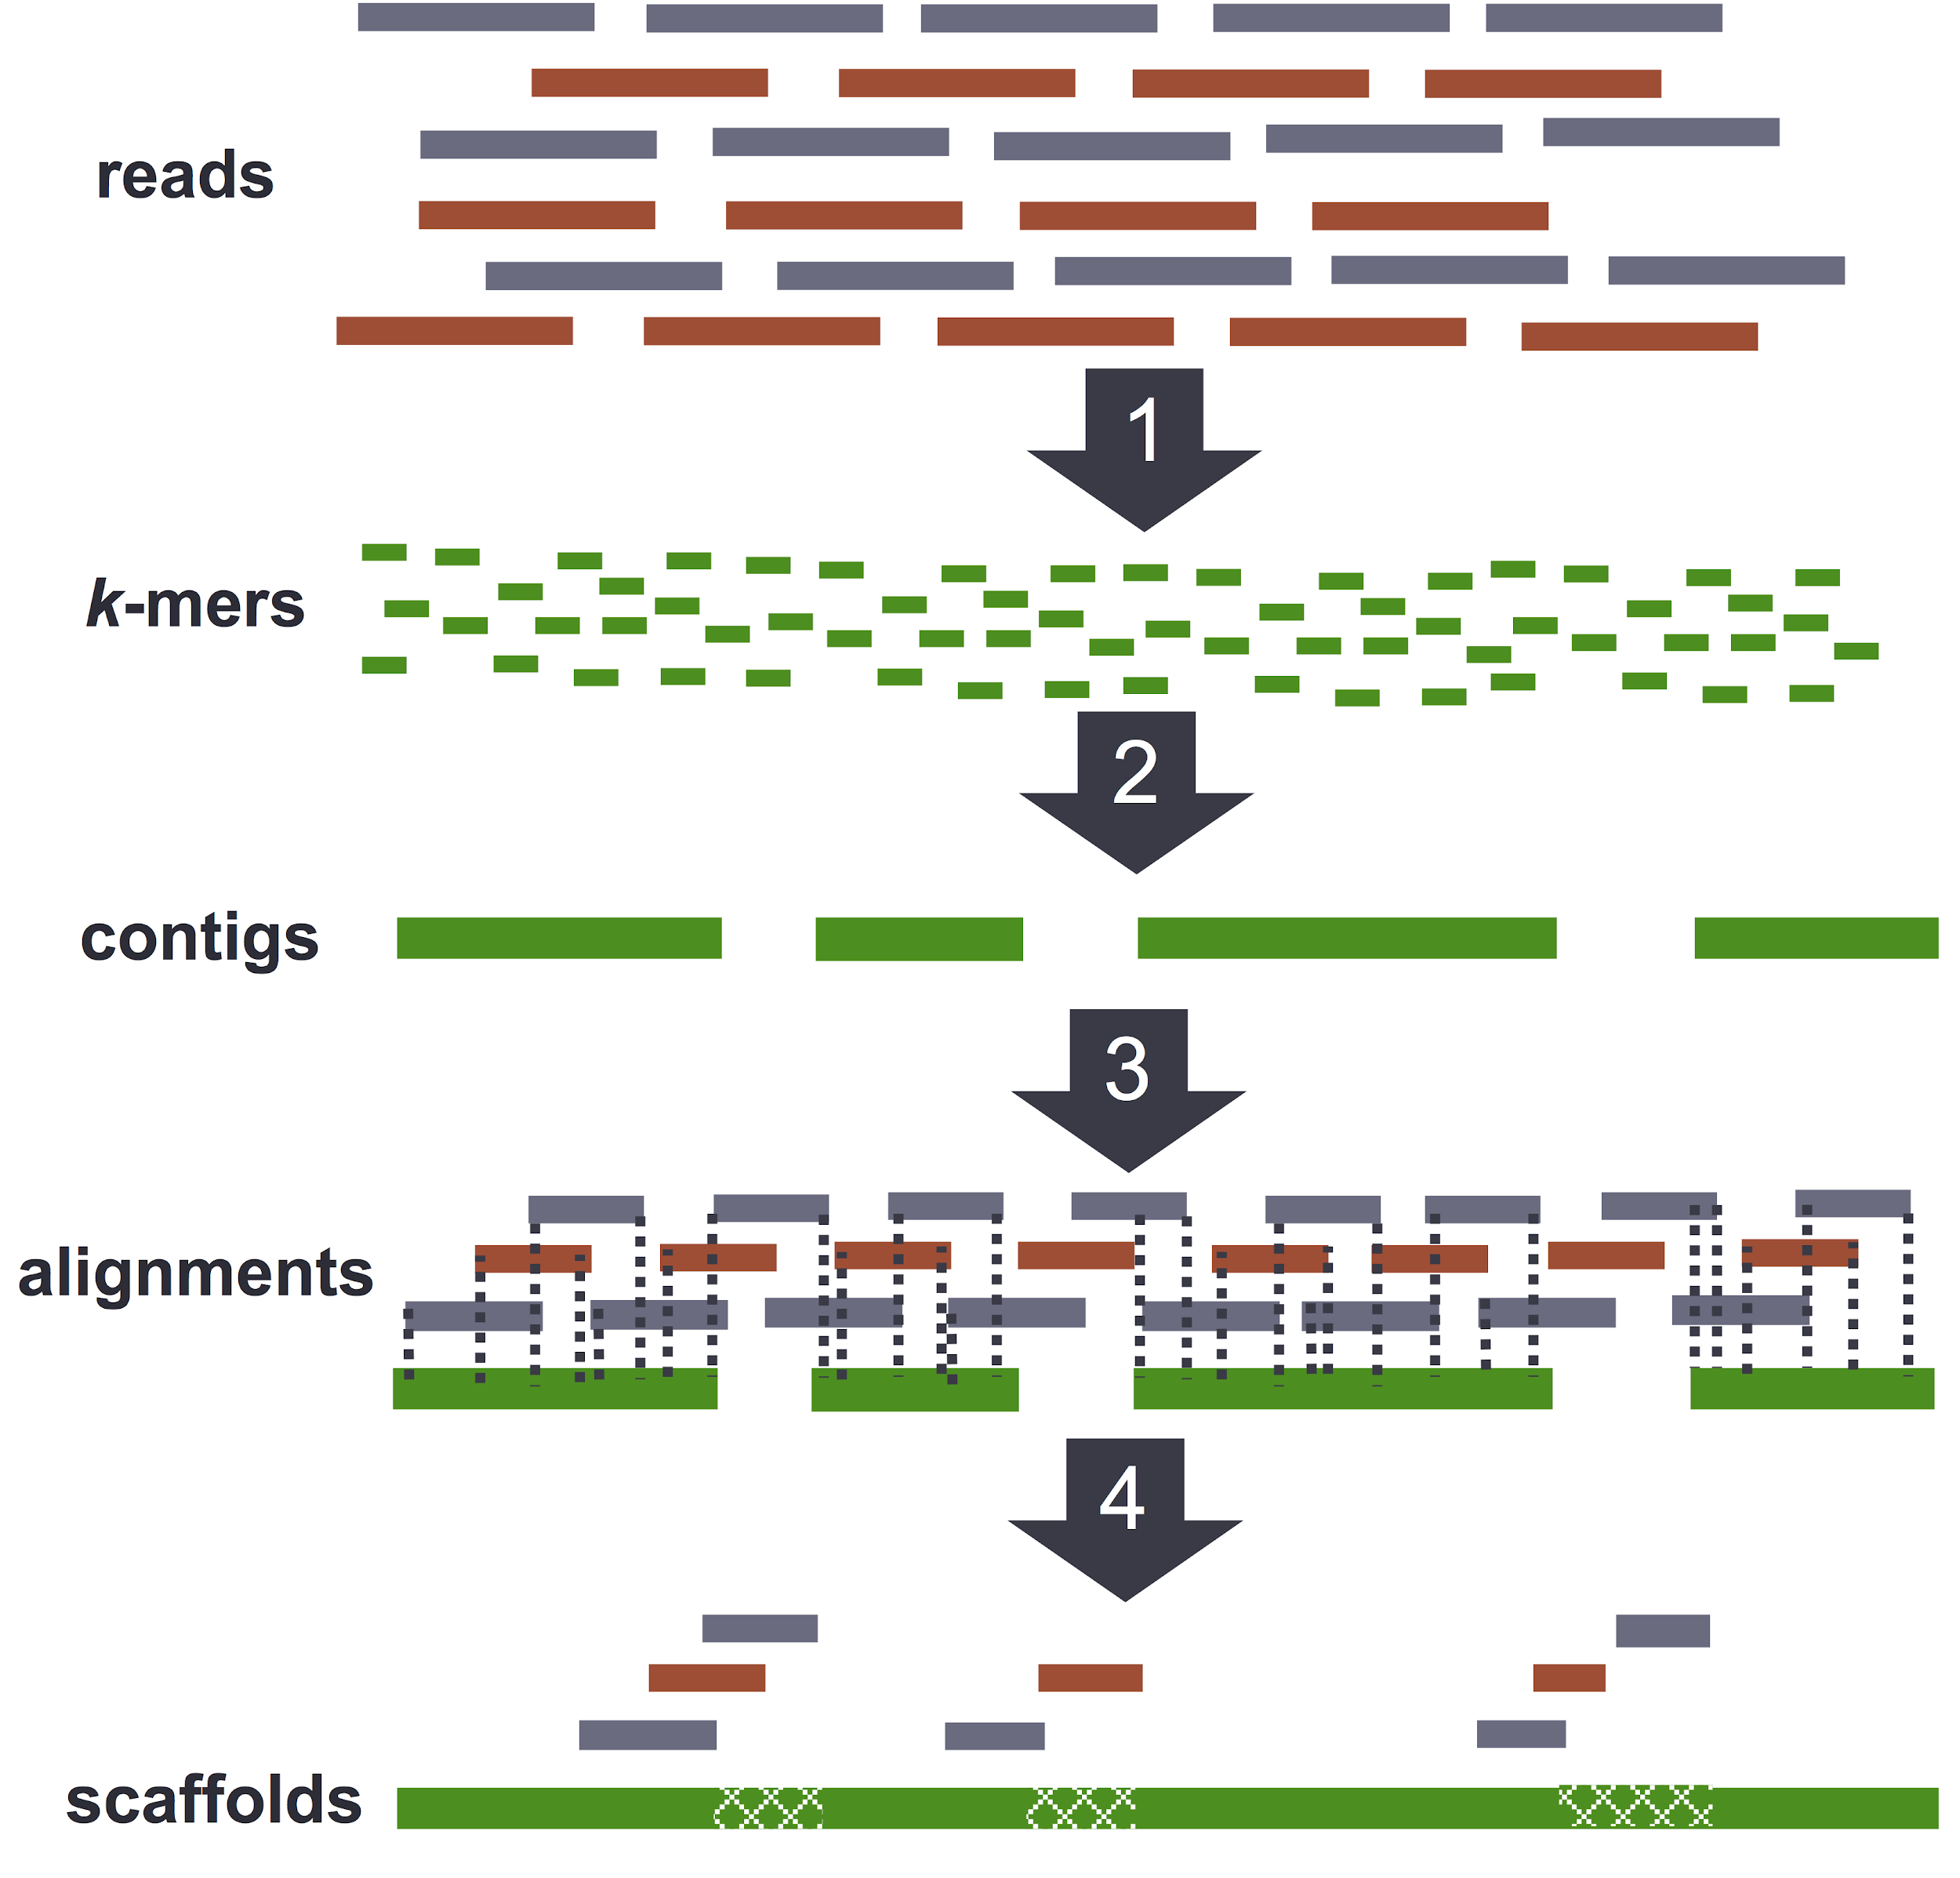
The HipMer Pipeline Overview
K-mer Analysis
Contig Generation
Sequence Alignment
read-contig
Scaffolding & Gap Closing
contig-contig
Notes:
Meta: avoiding defining and using additional terminology.
Our application benchmark follows the approach of the Meraculous assembler.
Meraculous is a serial assembler that has been studied exhaustively and found
to excel relative to other assemblers in most metrics [6].
In stage 1, K-mer Analysis, shorter overlapping sequences of length k
are extracted from the input DNA fragments, called reads,
and these k-mers are analyzed with respect to error and redundancy rates,
and filtered probabilistically.
In stage 2, Contig Generation, we use the k-mers to build a de bruijn subgraph,
and traverse the graph to produce contiguous sequences,
usually longer than the original reads,
dubbed “contigs”.
In stage 3, Sequence Alignment, we map the original reads back onto the
contigs to determine relative orderings and orientations of the contigs
Finally, in Scaffolding and Gap Closing stage, we “stitch” the contigs together
Using the reads and the previously generated reads-to-contigs alignment.
You will find more details of these algorithms and the implementation in the paper
and the references.
Traditionally, large-memory specialized machines have been used to run these algorithms...
Notes:
An n-dimensional debruijn graph with m symbols is a directed graph representing overlaps between sequences of symbols.
It has m^n vertices consisting of all possible n-length sequences of the given symbols.
The same symbol may appear multiple times in a sequence.

Slide 15
The HipMer Pipeline Overview
K-mer Analysis
extract, redistribute, & count k₁-mers
(redistribute with irregular all-to-all)
read-contig
contig-contig

Slide 16
The HipMer Pipeline Overview
Contig Generation
hash k₁-mers
find k₁-mer to k₁-mer links, form contigs
(async irregular all-to-all,
irregular lookups,
global atomics)
read-contig
contig-contig

Slide 17
The HipMer Pipeline Overview
Sequence Alignment
hash k₂-mers (longer k-mer from contigs)
find k₂-mer (from reads) to
k₂-mer (from contigs) alignments
read-contig
(async irregular all-to-all,
irregular lookups)
contig-contig

Slide 18
The HipMer Pipeline Overview
The HipMer Pipeline Overview
(async irregular all-to-all,
irregular lookups,
global atomics)
read-contig
Scaffolding & Gap Closing
hash contig pairs
form chains of contigs
contig-contig

Slide 19
The HipMer Pipeline Overview
The HipMer Pipeline Overview
distributed hash tables all the way down...
Hash Table (Graph) Construction
asynchronous irregular all-to-alls
Hash Table (Graph) Traversal
Irregular (local or global) lookups
Global atomics
Notes:
the construction and traversal patterns remain the same.
In each of these stages,
the hash tables are constructed using asynchronous all-to-alls,
and traversed using irregular lookups,
which might be on or off node,
and global atomics.

Slide 20
The HipMer Pipeline Overview
The HipMer Pipeline Overview
K-mer Analysis
irregular all-to-all
extract, redistribute, & count k₁-mers
Contig Generation
async irregular all-to-all,
irregular lookups,
global atomics
hash k₁-mers
find k₁-mer to k₁-mer links, form contigs
Sequence Alignment
async irregular all-to-all,
irregular lookups,
hash k₂-mers
(longer k-mer from contigs)
find k₂-mer (from reads) to
k₂-mer (from contigs) alignments
read-contig
Scaffolding & Gap Closing
hash contig pairs
form chains of contigs
async irregular all-to-all,
irregular lookups,
global atomics
contig-contig

Slide 21
The HipMer Pipeline Overview
The HipMer Pipeline Overview
K-mer Analysis
irregular all-to-all
Compute-bound
(due to efficient collective all-to-alls with large messages)
Contig Generation
async irregular all-to-all,
irregular lookups,
global atomics
Sequence Alignment
async irregular all-to-all,
irregular lookups,
Communication-bound
(particularly, latency and injection bandwidth bound)
Scaffolding & Gap Closing
async irregular all-to-all,
irregular lookups,
global atomics

Slide 22
Application Benchmark Results
Notes:
Finally, to the application benchmark results,

Slide 23
Application Benchmarking Overview
Results presented for:
5 platforms
3 supercomputers (including #4* and #6 on TOP500, 2017)
1 ethernet cluster composed of 3 special purpose nodes
1 infiniband cluster in a larger heterogeneous biology application cluster
2 genomic data sets
Human chromosome 14 (approx. 100 million base pairs - relatively small)
Human genome (approx. 3 billion base pairs - relatively medium)
Strong Scaling
Single node
Multi-node (into 100s)
1000s of nodes
*#4 is being utilized without GPU acceleration, so performance closer to its pre-GPU performance as #6 on Top500, 2012
Notes:
We present HipMer performance results and analysis
across 5 systems,...
And the presented results are for 2 genomic data sets,
the human genome, and the human chromosome 14,
which, to give you a sense of the size,
are approximately 3 billion and 100 million nucleotide bases in size, respectively.
...
I will interleave the specific machine information
with the results to spread out the information dump.

Slide 24
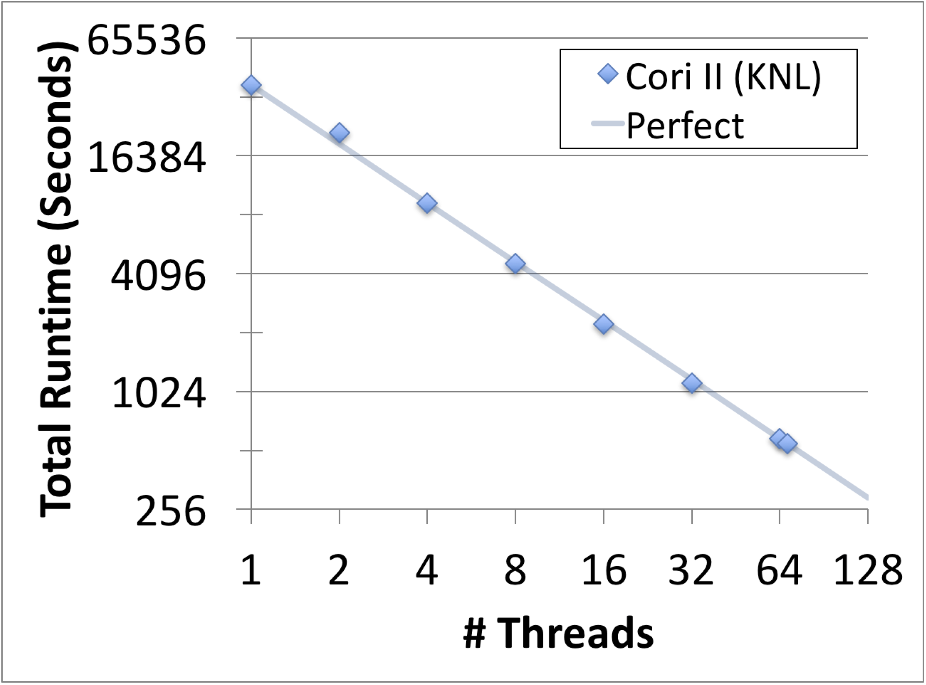
Single Node Strong Scaling (Baseline)
Intel KNL
Perfect
Perfect Manycore Scaling
Perfect Multicore Scaling
* Using flat Unified Parallel C (UPC) primarily
Notes:
This shows the overall application runtime over the number of threads (1 per core),
on our largest single node architecture, the Intel Xeon-Phi Knights Landing,
currently installed in Cori, a Cray XC40 at NERSC.
The input was a human chromosome 14 data set, a data set small enough to complete the pipeline on a single node across all our systems, but large enough to stress the nodes a bit.
As you can see, the application scales perfectly from 1 to 68 threads.
(not shown)
Using 2 threads per core yielded ~19% improvement,
and using 4 threads per core yielded ~3% improvement over 2 threads per core.
However, we stick with 1 thread per core through the remainder of the study,
since the higher concurrencies from hardware threading can negatively affect off-node communication.
Notes:
Human chromosome 14 is 106,360,585 base pairs

Slide 25
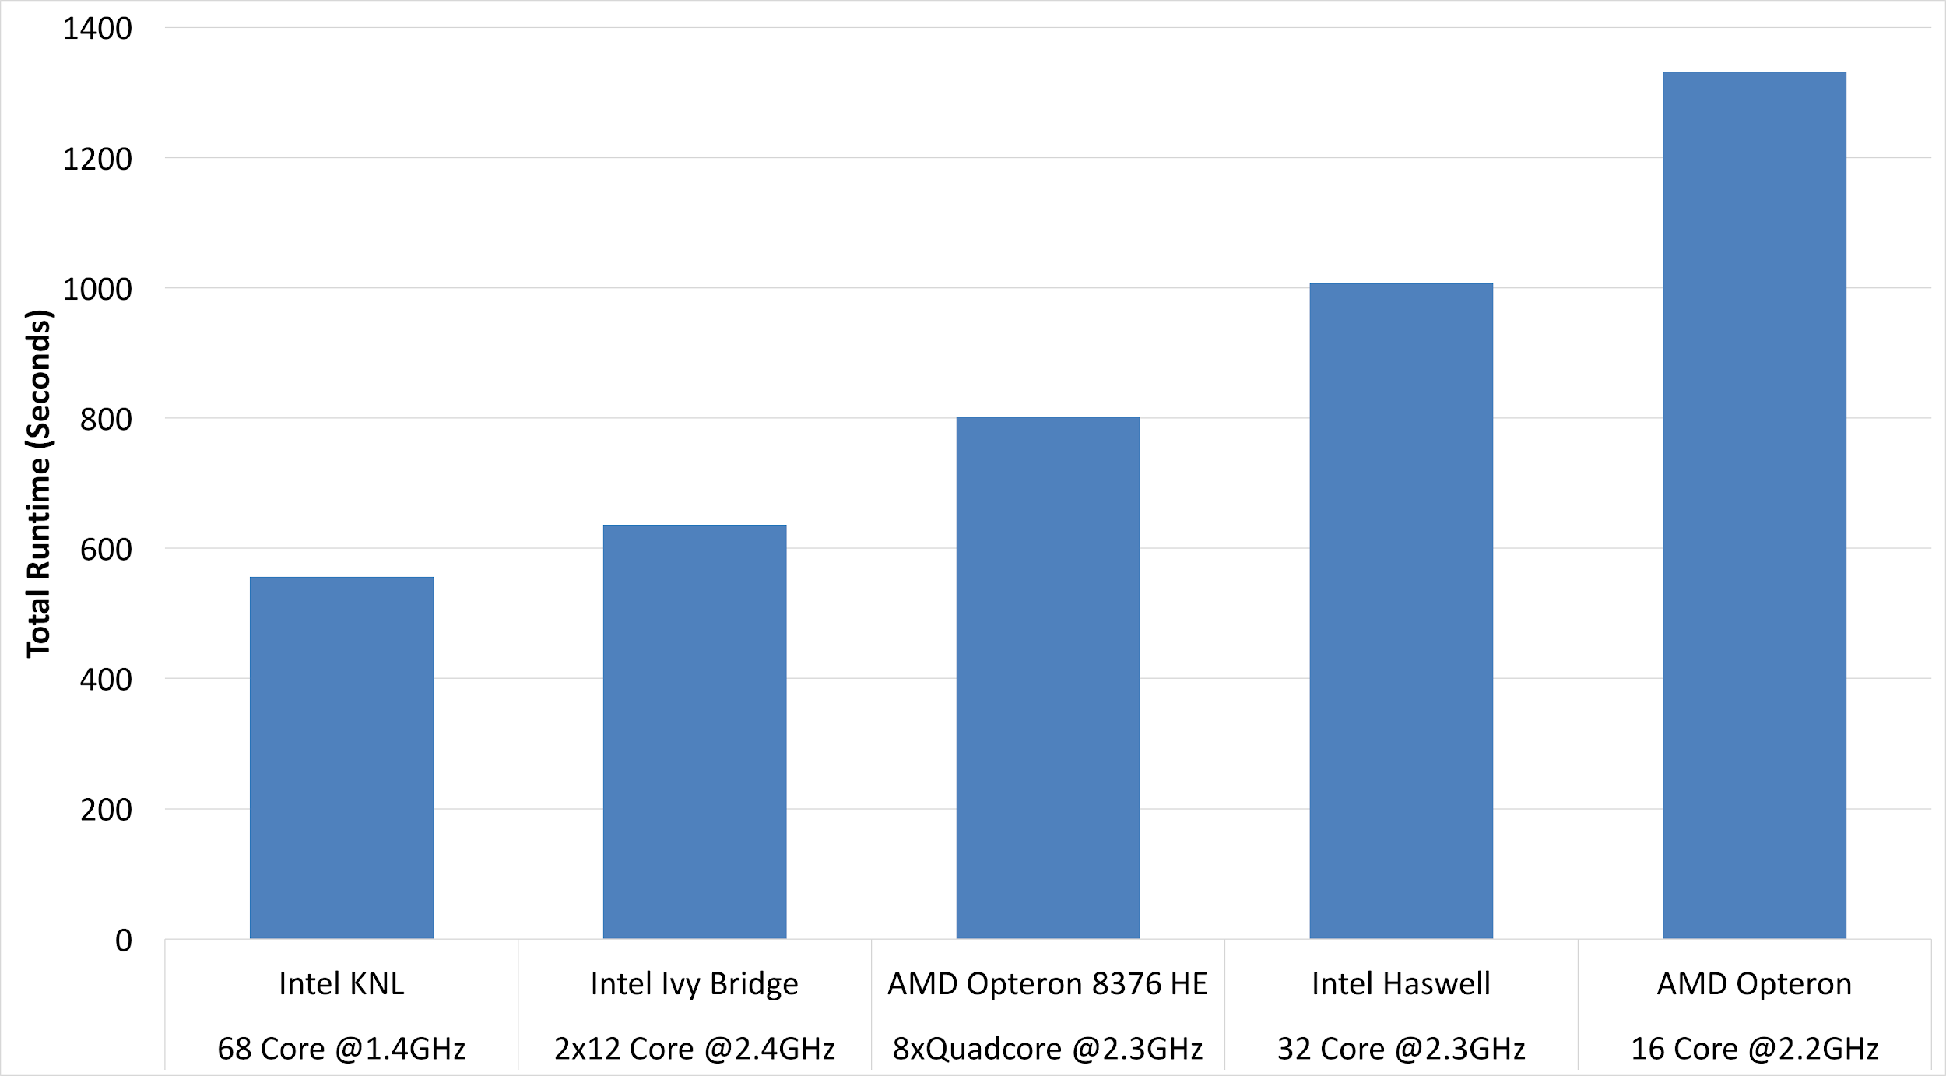
Single Node Strong Scaling (Baseline)
Single Node Strong Scaling (Baseline)
Absolute total time differs by maximum 2.4x across architectures
2.4x

Slide 26
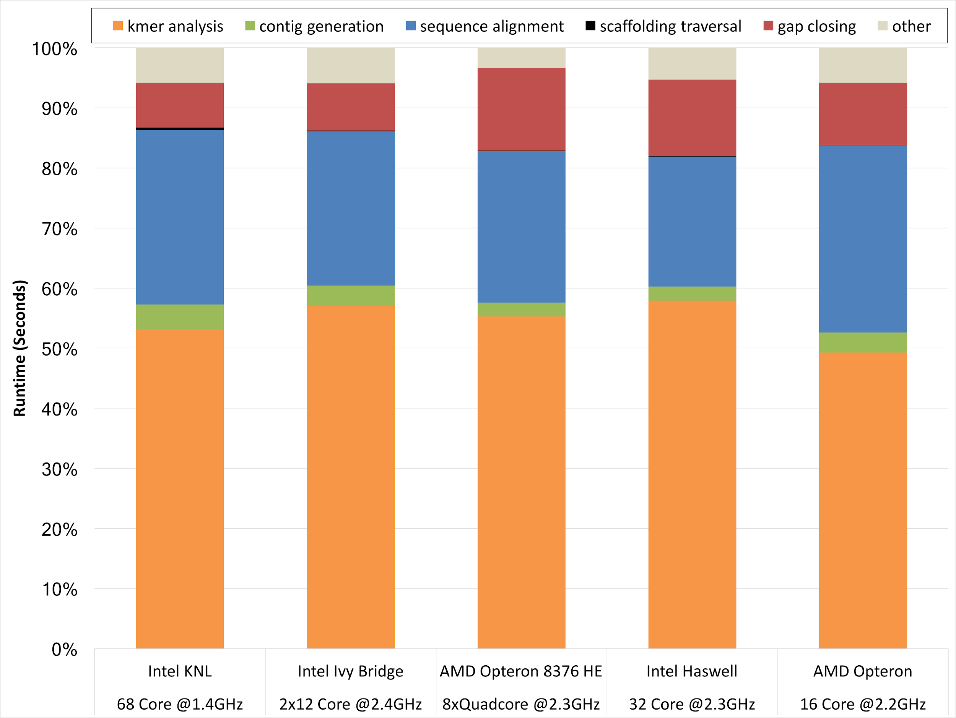
Single Node Strong Scaling (Baseline)
Single Node Strong Scaling (Baseline)
Ratio of time-per-stage to total-per-machine similar across all architectures
3-6% other (facilitating) modules
8-13% gap closing
< 1% scaffolding traversal
21-31% sequence alignment
2-4% contig generation
48-57% k-mer analysis

Slide 27
Single Node Strong Scaling (Baseline)
Single Node Strong Scaling (Baseline)
Intermediate Summary Points
HipMer demonstrates excellent single node scalability
(for data sets small enough for a single node)
across node architectures
without being optimized for any of these architectures in particular
When we look at the multinode results, we can be confident,
significant performance differences are not due to node architecture
and rather focus on internode aspects
Notes:
This shows the overall application runtime over the number of threads (1 per core),
on our largest single node architecture, the Intel Xeon-Phi Knights Landing,
currently installed in Cori, a Cray XC40 at NERSC.
The input was a human chromosome 14 data set, a data set small enough to complete the pipeline on a single node across all our systems, but large enough to stress the nodes a bit.
As you can see, the application scales perfectly from 1 to 68 threads.
(not shown)
Using 2 threads per core yielded ~19% improvement,
and using 4 threads per core yielded ~3% improvement over 2 threads per core.
However, we stick with 1 thread per core through the remainder of the study,
since the higher concurrencies from hardware threading can negatively affect off-node communication.
Notes:
Human chromosome 14 is 106,360,585 base pairs

Slide 28
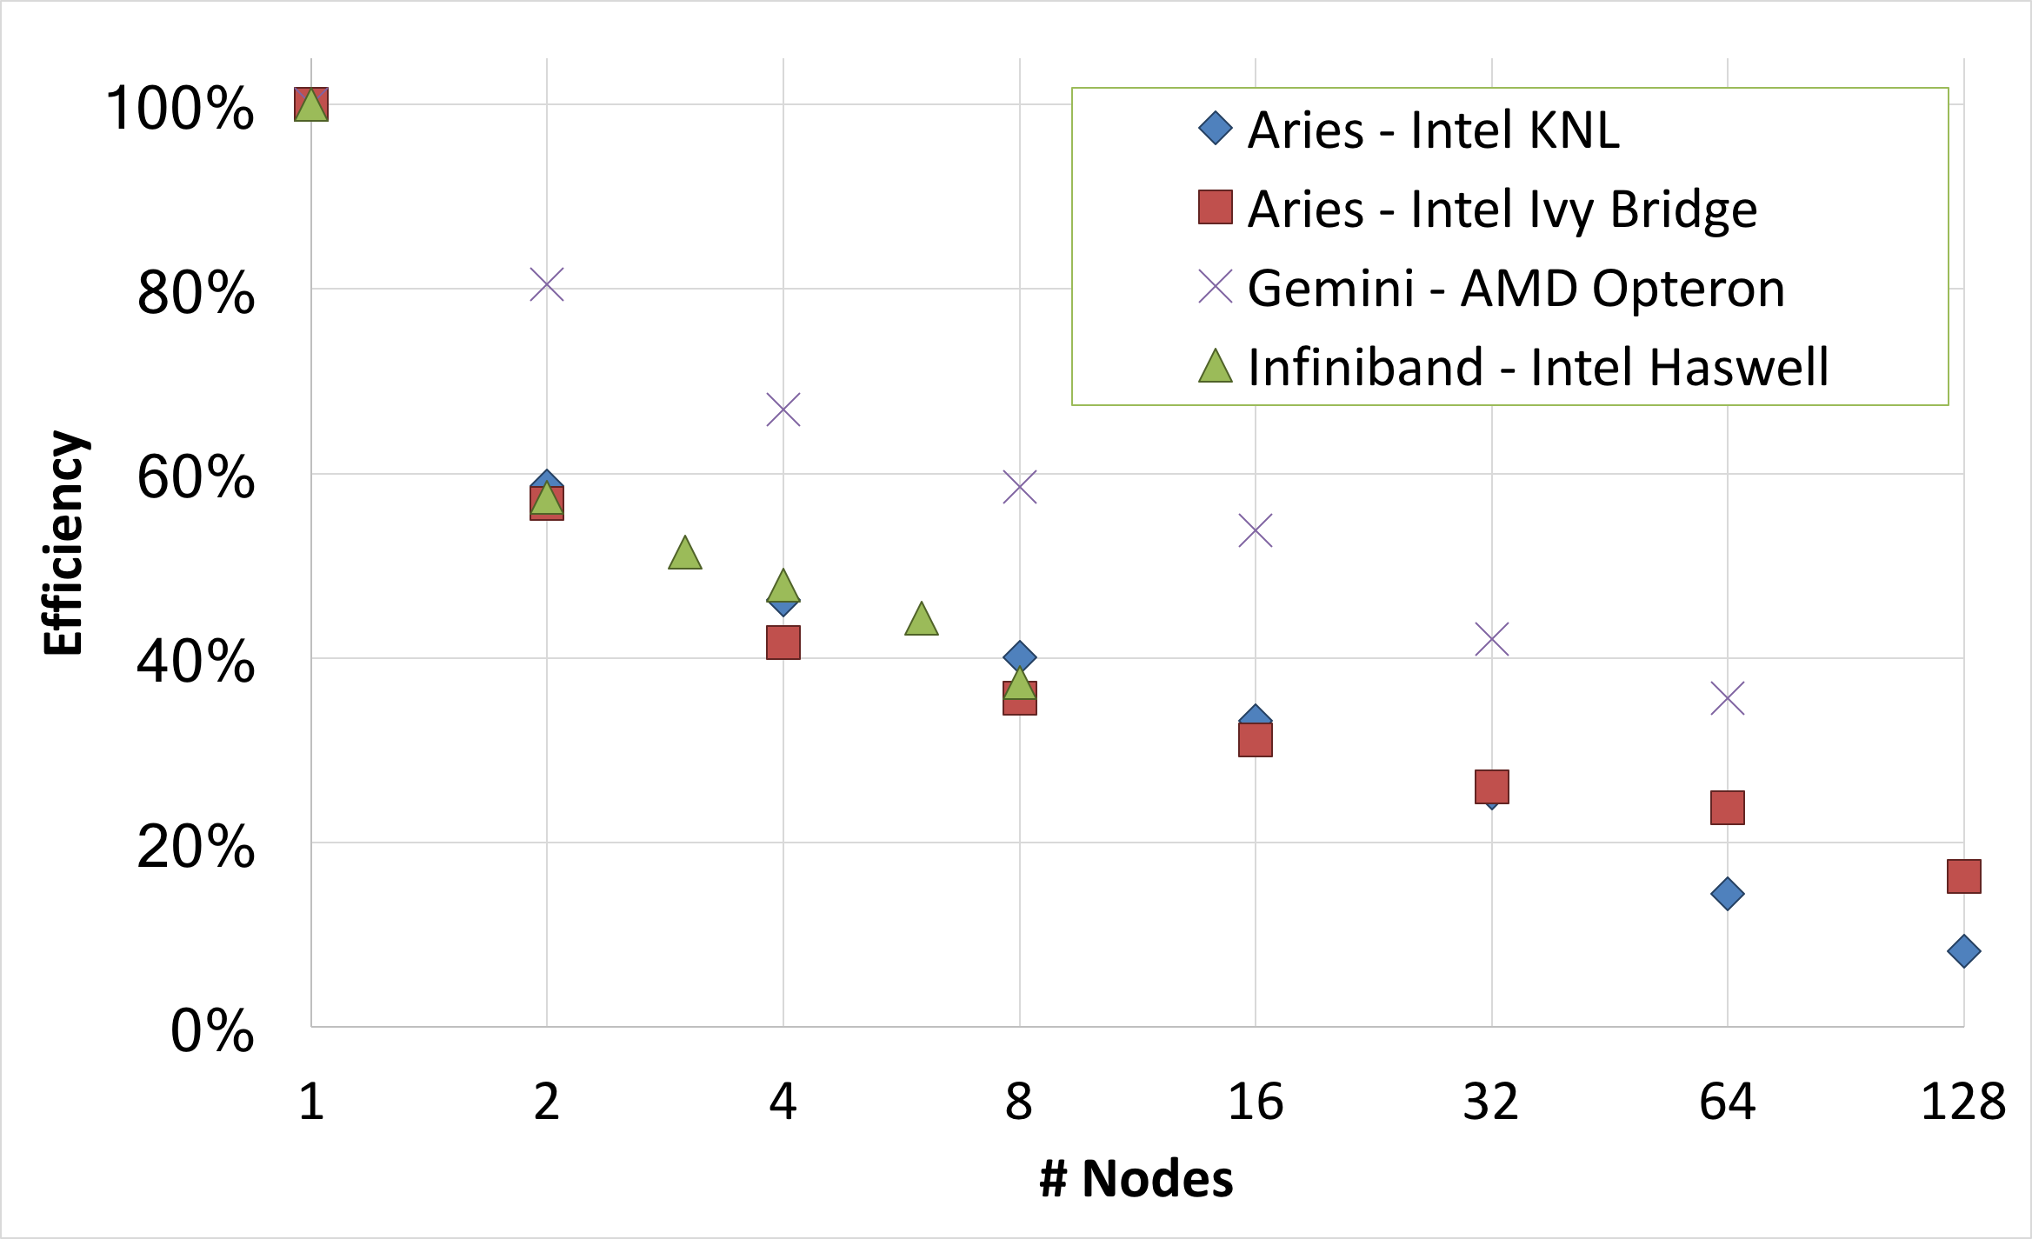
Multi-Node Strong Scaling
HipMer scales efficiently to 100’s of nodes (and 1000’s, shown later)
3x drop in
efficiency
* Efficiency calculated over # nodes
64x increase
in parallelism
** Note, NOT percentage of peak efficiency

Slide 29
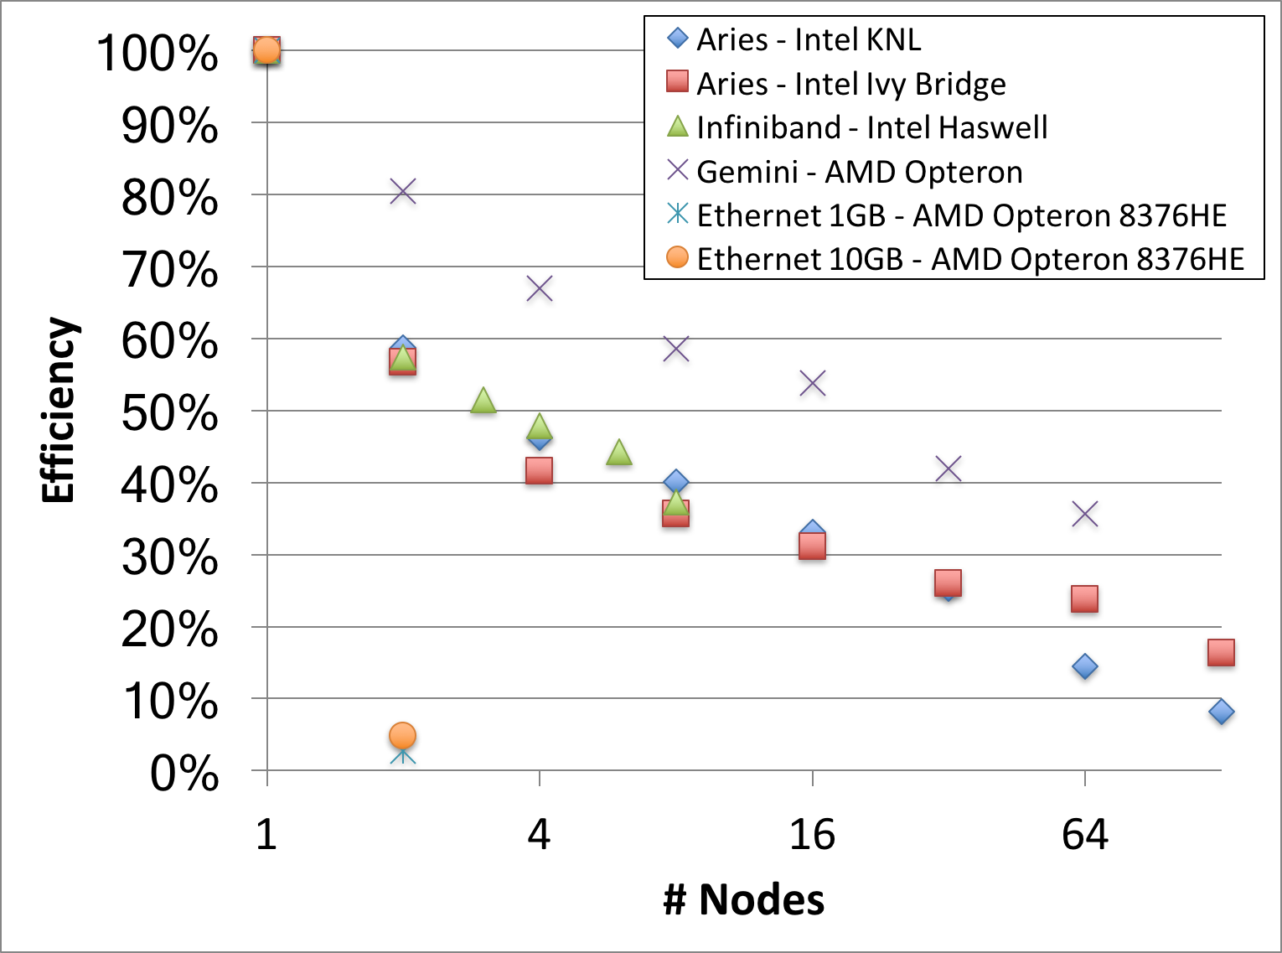
Multi-Node Strong Scaling
Multi-Node Strong Scaling
Requires fast underlying network (e.g. NOT ethernet)
Ethernet cluster efficiency, on 10Gb fiber optic patch and
1Gb switch respectively, drops
95% and 97% from 1-2 nodes
~95% drop

Slide 30
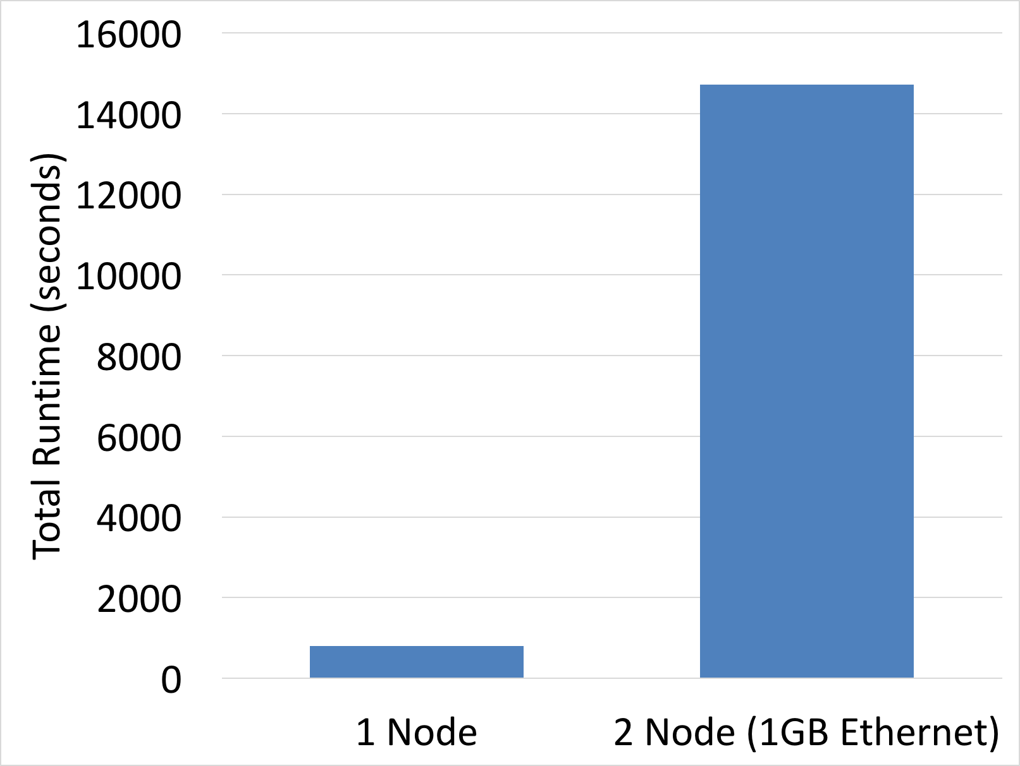
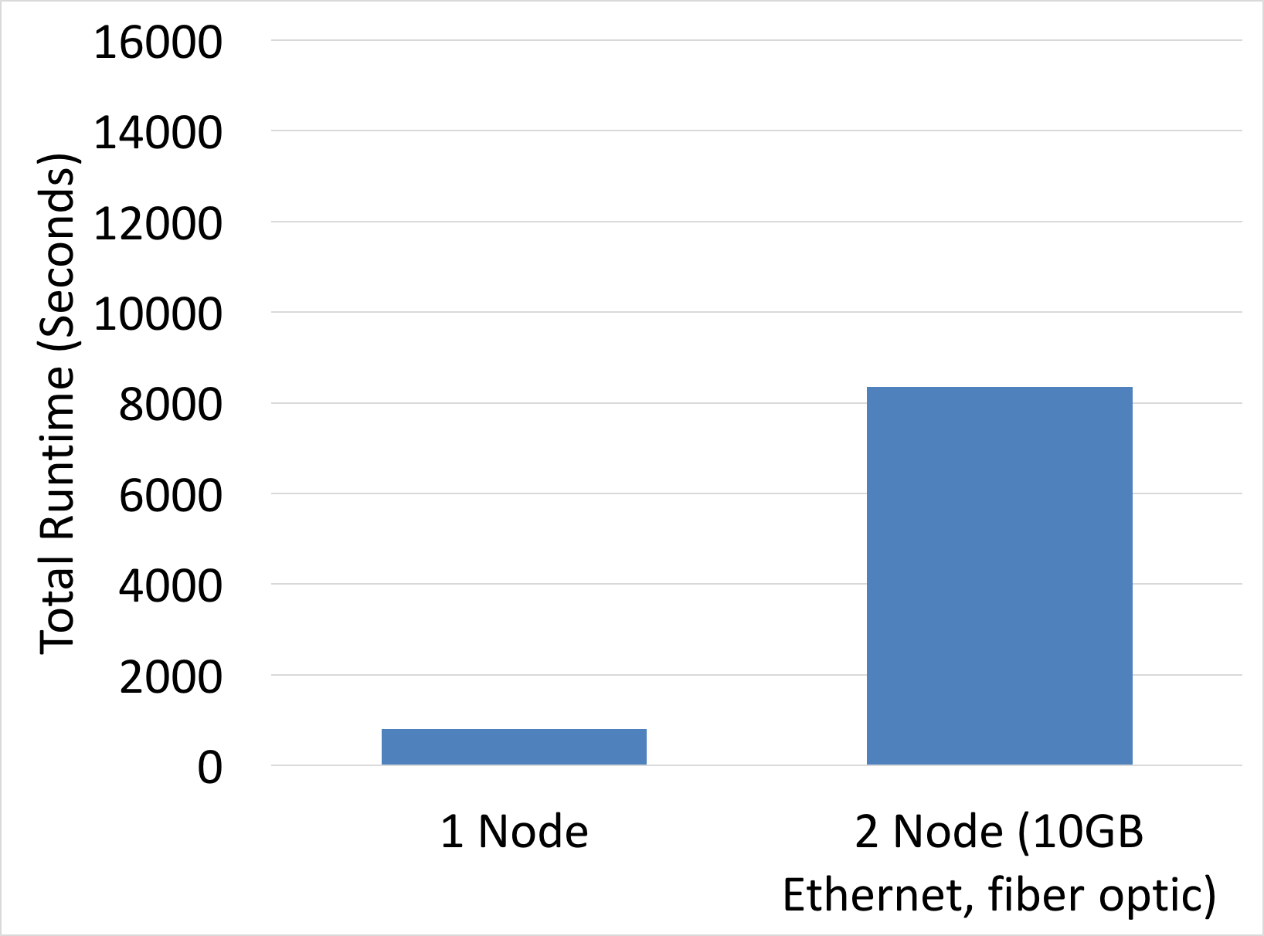
Multi-Node Strong Scaling
Multi-Node Strong Scaling
Requires fast underlying network (e.g. NOT ethernet)
Ethernet slowdown 18x (on 1Gb switch) and 10x (on 10Gb fiber optic patch)
18x slowdown
10x slowdown

Slide 31
1-2 Node Scaling, Closer Look
At 1 node, all communication is within the memory subsystem
At 2 nodes, roughly half the communication is off-node
The 2 node performance breakdown clearly demonstrates network speed impact, along with microbenchmarking data

Slide 32
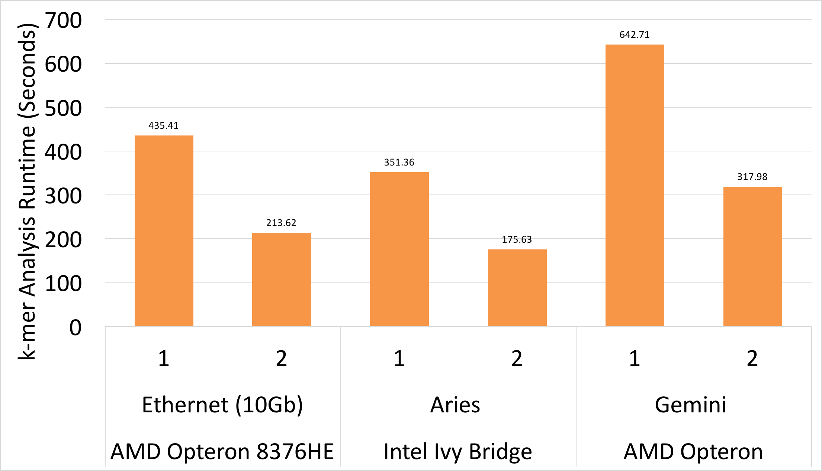
1-2 Node Scaling, Closer Look
1-2 Node Scaling, Closer Look
k-mer Analysis (computation-bound stage) scales linearly:
2.0x speedup

Slide 33
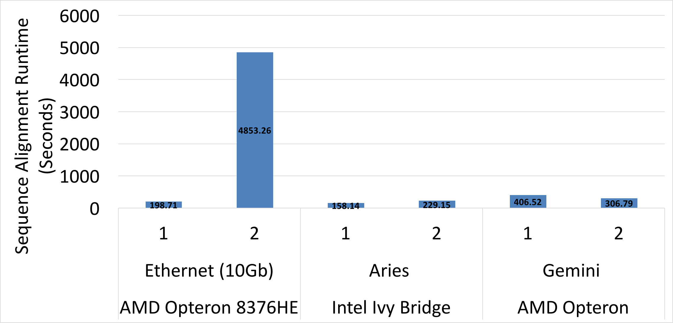
1-2 Node Scaling, Closer Look
1-2 Node Scaling, Closer Look
Communication-bound stages’ scaling depends on network,
e.g. consider Sequence Alignment (a latency-bound stage):
24x slowdown
1.3x speedup
1.4x slowdown
Notes:
Irregular lookups (latency-bound) dominate the Sequence Alignment stage

Slide 34
1-2 Node Scaling, Closer Look
1-2 Node Scaling, Closer Look
Fine-grained (latency-bound) irregular lookups dominate → low network latency is key
 | Ethernet | XC30 - Aries | XK7 - Gemini
Intra-node LAT | 0.57 | 0.75 | 1.1
2-node LAT | 291.24 | 2.39 | 1.79
24x slowdown
1.4x slowdown
1.3x speedup
- microseconds
- 128byte msg.
- using optimal number of cores per node
Notes:
Irregular lookups (latency-bound) dominate the Sequence Alignment stage

Slide 35
Multi-Node Strong Scaling
Multi-Node Strong Scaling
Efficiency
T₁ / (T_{p} * p)
where p is in terms of # nodes
40% ⬇
< 10% ⬇ btwn any 2 levels
≤ 26% ⬇
Notes:
Returning to multinode scalability, we can understand this graph a little bit better...

Slide 36
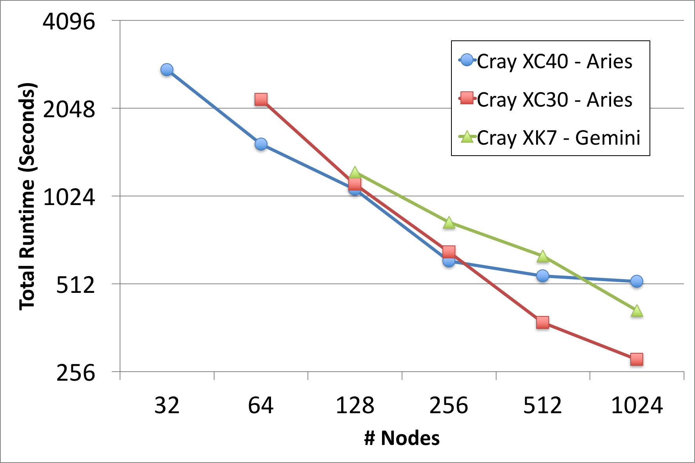
Multi-Node Strong Scaling
Multi-Node Strong Scaling
HipMer scales efficiently to 100’s and 1000’s of nodes
Human Genome Results (Medium-sized Problem)
Minimum aggregate memory required
Note, difference in cores per node contributes to some machines running out of work faster, combined with network contention overhead, etc.
Notes:
Looking closely at the XC30 trendline, which differs from the XC40 and XK7 by < 4% for the majority of the time...

Slide 37
Summary
This is a first cross-architectural evaluation of large-scale de novo genome assembly
It is a challenging application to scale due to the dominance of fine-grained irregular memory accesses within and between nodes
We have demonstrated efficient scalability
using (1) async all-to-alls (2) irregular lookups and (3) global atomics
Key network features are low-latency and high-injection rates
Microbenchmarks capture the key characteristics

Slide 38
Future Work
Larger problem sizes
On-Node Performance Optimizations
Current code isn’t vectorized
or adapted for GPUs.
Some improvement in absolute performance is expected from these optimizations, though communication (intranode concurrent memory access and internode one-sided operations) will still be dominant.
Hardware atomics

Slide 39
Final Remarks
Software Available
HipMer: https://bitbucket.org/berkeleylab/hipmeraculous
Microbenchmarks:
Release planned for this year - connect with me online via LinkedIn or mme@eecs.berkeley.edu, for live update.

Slide 40
Thank you!

Slide 41
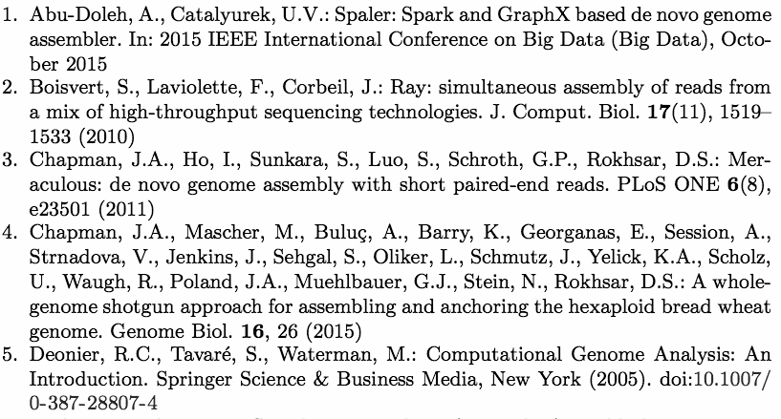
References

Slide 42
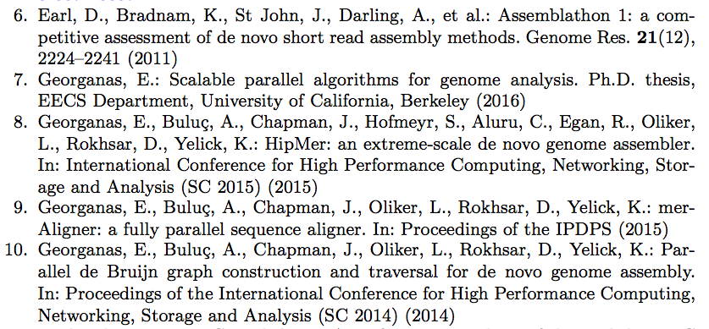
References
References

Slide 43
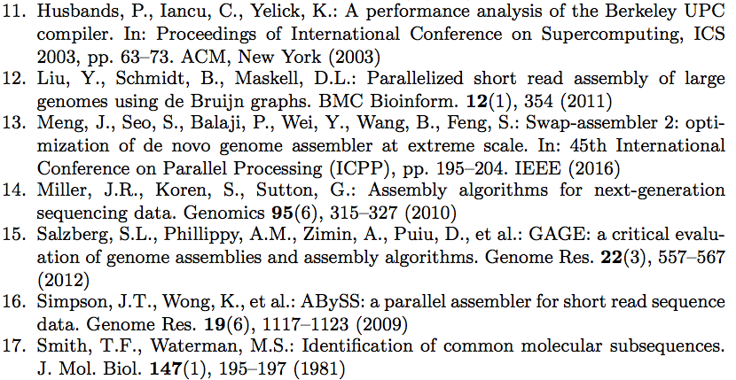
References
References

Slide 44
Additional Slide Content Credits
Clip Art
3. (genomics icon) https://databricks.com/, (energy, environment) http://www.pngall.com, (medical symbol) http://www.studymedicineatoz.com, (medicine pile) http://www.bentleyvillecommunicationscorp.com
5. (magnifier) http://srehsv.com
Contributed Slide Content
Coauthor, Evangelos Georganas, contributed body of slides 9, 12, and 13 from SC’15 presentation. Content has also appeared in presentations by Aydin Buluc.

Slide 45
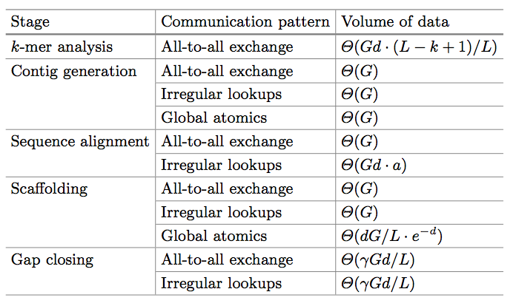
Appendix: The Underlying Communication Patterns
G size of the underlying genome
d coverage
L the average read length
a the average number of contigs each read aligns to
𝛾 fraction of reads not assembled into contigs
Notes:
This is the summary of the communication patterns and data volumes we’ve identified
for each stage, and there’s no need to read this entire wall of text,
you can refer to the paper for details of this analysis.
One of the key observations supporting our later performance analysis is that
we can use microbenchmarks to measure these particular communication patterns,
patterns not uncommon in distributed versions of irregular applications,
and measure them across systems,
to better understand and predict performance
across system architectures.
____________________________________________________________
Notice, that each stage includes asynchronous all-to-all exchanges,
proportional to the size of the underlying genome.
Four out of 5 of them require irregular lookups, again in the size of the genome.
And at least 2 of them additionally require the use of global atomic operations,
again in the size of the genome.

Slide 46
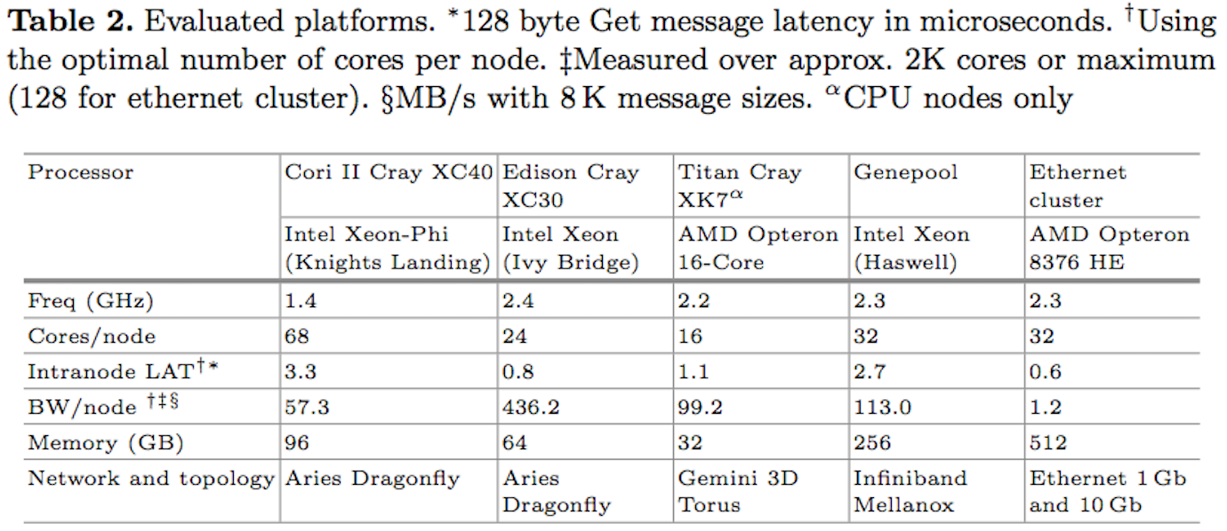
Appendix: Machine Reference

Slide 47
Appendix: HipMer Parallelization
Partitioned Global Address Space (PGAS)
Unified global address space
global memory partition
global memory partition
global memory partition
global memory partition
private local memory
private local memory
private local memory
private local memory
...
P0
P1
P2
PN
Facilitates shared-memory-like accesses, shared distributed data structures, etc.
Notes:
In order to efficiently support the irregular access patterns in this application,
while exploiting the resources of a distributed system,
HipMer utilizes a partitioned global address space (PGAS)
In the language Unified Parallel C (UPC).
PGAS a distributed model in which each processor/thread has direct, one-sided access to every other processor/thread’s global memory partition,
through a unified global address space.
This model underlies the data structures and communication patterns I’m about to discuss.
________________________________________________________________
Our implementation is in a PGAS language called Unified Parallel C (UPC),
which supports convenient implementation of shared distributed data structures, one-sided communication operations, including asynchronous collectives, in addition to traditional bulk-synchronous collective operations.
* focus on parts relevant for understanding the communication patterns and benchmarking results (what’s being benchmarked)
Kmer-analysis
Parallel I/O + perfectly parallel local computation + bulk synchronous communication
Contig Generation
Debruijn graph is stored in a hash table
Our implementation supports asynchronous lookups and global atomic operations
Enabling parallel traversal of the graph
Sequence alignment similarly requires irregular lookups
Distinct subset of the contigs stored in each thread’s global address space partition
Finally the scaffolding and gap closing stage have very similar patterns to the previous stages.
// TODO study details more
These data structures and operations, genomics aside, are ones you could expect to be useful in other distributed irregular and graph analytic computations.

Slide 48
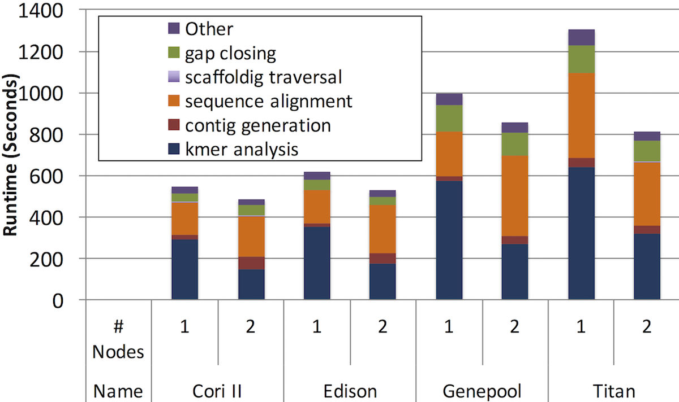
Appendix: Scaling 1-2 Nodes (More Detail)
Ethernet (>10x slowdown) not shown due to scale
Computation-bound stages (e.g. kmer analysis) scale ~linearly
Scaling of communication bound stages (e.g. sequence alignment) depends on the network
Network
Aries
Aries
Infiniband
Gemini
Notes:
Scaling from 1 to 2 nodes introduces internode communication overhead.
Speedups:
1.12-1.18x on Cor II, Edison, Genepool
1.6x on Titan
Slowdowns:
18.2x Ethernet 1GB
10.6x Ethernet 10GB
Ethernet...
Computation-bound stages...
Collective all-to-all effectively utilizes the available bandwidth
For the communication-bound stages such as sequence alignment,
Sequence alignment necessitates irregular lookups,
implemented here with get operations,
which are latency-bound.
Moving from 1 to 2 nodes, about half of these operations can be expected to be off-node,
So the underlying network latency really makes a difference.
For example, Edison’s intra-node latency, as measured by our microbenchmarks is
0.75 microseconds, while the avg. latency between 2 nodes is 2.39 microseconds.
Genepool, as well, has an intranode latency of 2.7 microseconds, and an avg. 2-node latency of 6.5 microseconds.
Titan, 1.1 -> 1.8 microseconds

Slide 49
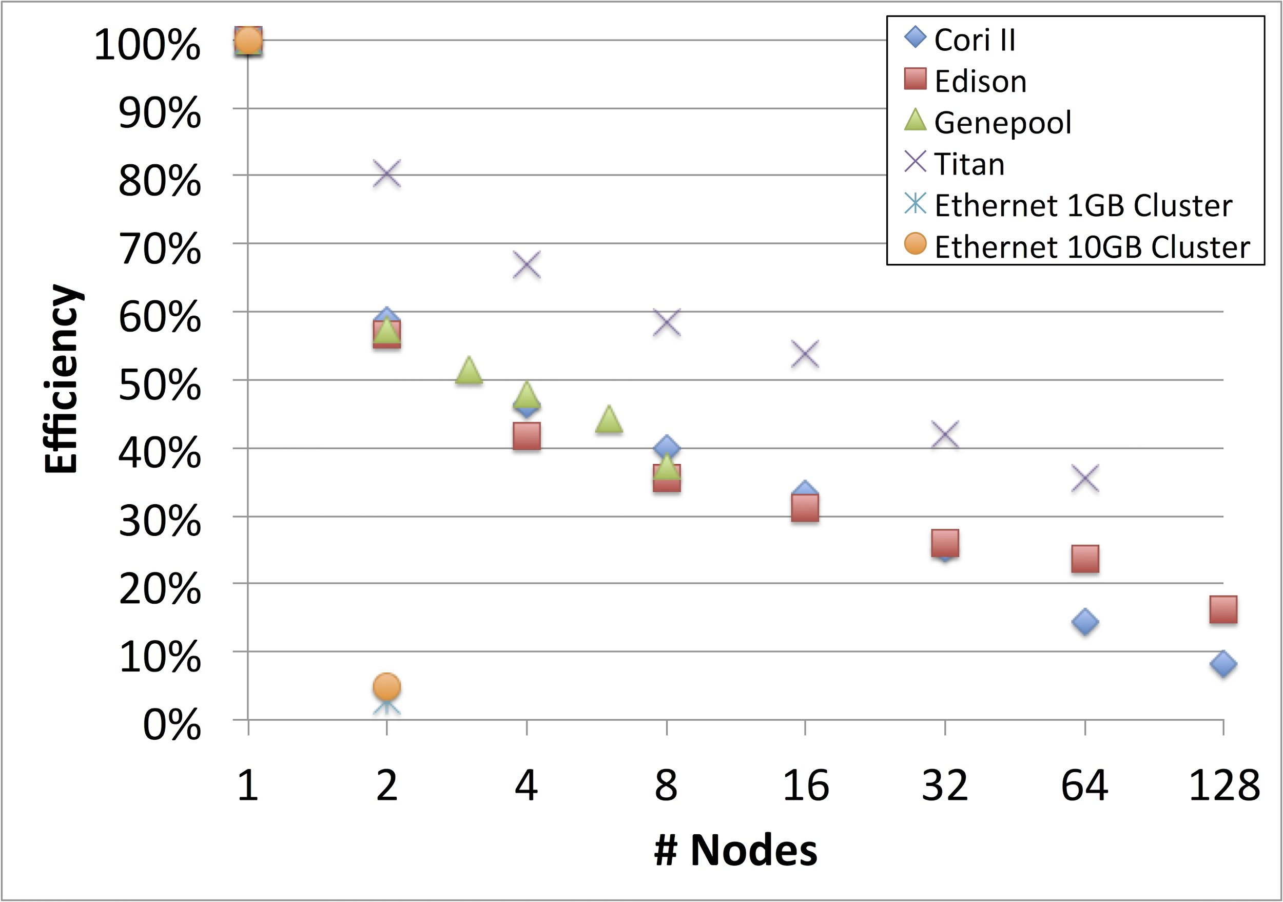
Appendix: Multi-Node Scaling (More Detail)
Efficiency
T₁ / (T_{p} * p)
≤ ~10% decrease per node level
~95% drop
crossover
≤~26% drop
Notes:
Same data set.
Efficiency is calculated as the total time on 1 node, over the parallel time, times the number of nodes, denoted as p, and shown on the x axis.
The ethernet cluster efficiency drops by ~95% between 1 and 2 nodes. Since it’s a 3 node cluster, we don’t present further data.
You’ll also notice that Titan maintains higher efficiency levels as we increase the concurrency levels. However, this does not equal better absolute performance. Titan’s absolute performance is much worse relative to the others’. And as the most memory and core starved machine among our set, it has the most to gain from more node resources.
For the other machines, there’s at most a 26% drop in efficiency between 2 and 8 nodes inclusive, and the strong scaling trend, with < 10% drops between node levels, continues.
The entire trend highlights the fact that parallelization over some minimum number of nodes is necessary to overcome the overhead introduced by internode communication,
and that the minimum number is dependent on the network and the node characteristics.
Once that minimum number is met, however, the application can scale to large numbers of nodes.
The last thing I’ll point out is, the crossover in efficiency between Cori and Edison.
Between 1 and 32 nodes there’s less than a 4% difference in their efficiencies.
At 64 nodes onward, Edison maintains roughly 10% higher efficiency than Cori.
The key factors here are the relatively small size of the data set and the difference in on-node parallelism between Cori and Edison.
At 64 nodes on Cori, the workload is parallelized on over 4K cores,
while on Edison, the workload is parallelized just over 1500 cores.

Slide 50
Appendix: Multi-Node Scaling (More Detail)
Strong Scaling Limits
Cori: 47% efficiency at 32,768 cores
Edison: 49% efficiency at 24,576 cores
Titan: 37% efficiency at 16,384 cores
4% serial scaffolding traversal
29% serial scaffolding traversal
Notes:
These results were collected using the entire human genome, whereas previously we’ve been looking at results for just 1 chromosome of the human genome.
The metric is total application runtime over the number of nodes.
We leave out our 3 node ethernet cluster since it took nearly an entire day to complete the assembly on 1 of those node, and using 2 of them resulted in a ~10x slowdown due to the internode communication overhead.
We also left out Genepool, since sufficiently many nodes to run the end-to-end pipeline on this data set were not reservable.
The first thing to notice is that we start with different numbers of nodes per machine.
This is because different minimum numbers of nodes are required per machine to meet the minimum aggregate memory requirement for the data and associated distributed data structures, which is roughly 4TB.
You’ll also notice each machine continues strong scaling to a certain point.
On Cori that’s 512 nodes...and on Edison and Titan... After this point, per thread work is insufficient.
Furthermore, the other factors influencing the scalability are the pipelines serial component, namely the scaffolding traversal, which consumes higher and higher percentages of the total runtime as parallelism increases,
and also the initial I/O loading time.
All the data is kept in memory in these experiments after this initial loading, but there’s still some overhead from the initial loading.
Notes:
Entire human genome is ~3 billion base pairs

